Slide 1
SMART HOME AUTOMATION SYSTEM
PRESENTED BY-
Mohd Abid

Slide 2
PROJECT OVERVIEW
This project uses an Arduino uno to build a smart system.
Integrates multiple sensors:
Ultrasonic sensor- Measures distance.
PIR motion sensor – Detects human motion .
LDR sensor- Detects ambient light level.
Gas sensor- Monitors gas leakage.
Controls appliances and alerts:
Relay module- Controls light.
Buzzer: Alerts on high gas levels.
LCD display- Shows sensor readings.

Slide 3
COMPONENTS USED
Arduino UNO
LCD 16x2 Display
LDR Sensor
Gas Sensor (MQ-2)
PIR Motion Sensor
Ultrasonic Sensor
Buzzer
Relay module
Power Supply
Resistor
Bulb
Dc Motor

Slide 4
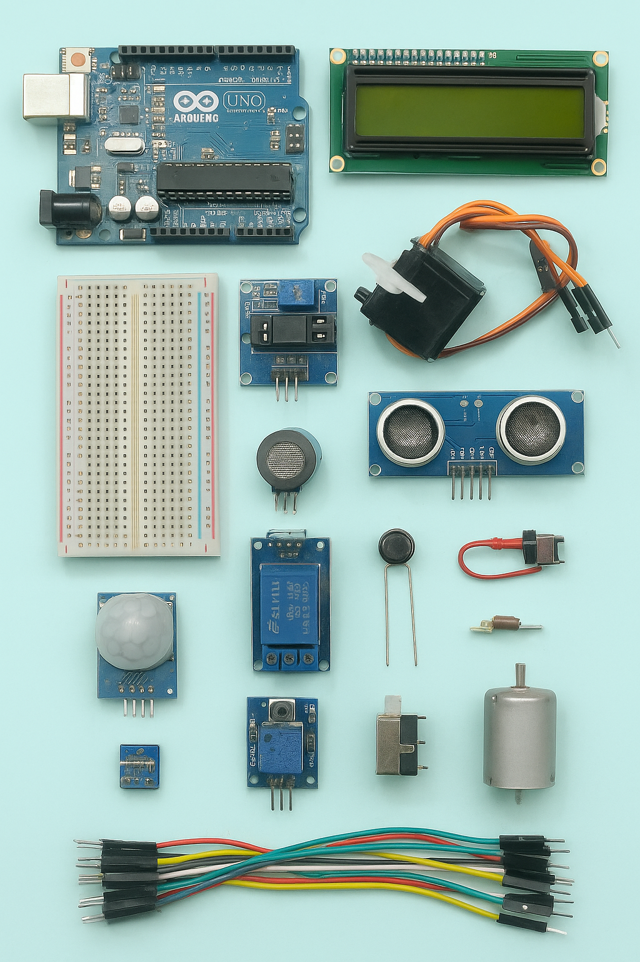

Slide 5
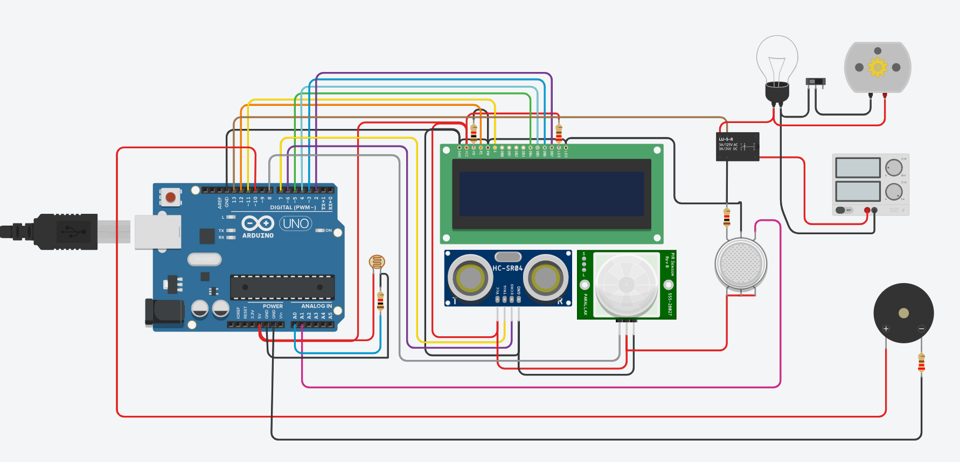
CIRCUIT DIAGRAM

Slide 6
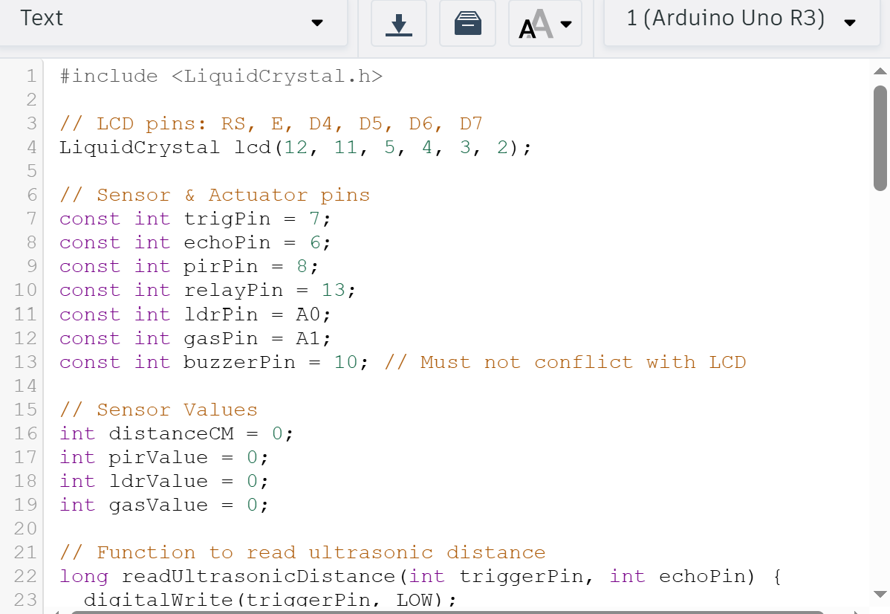
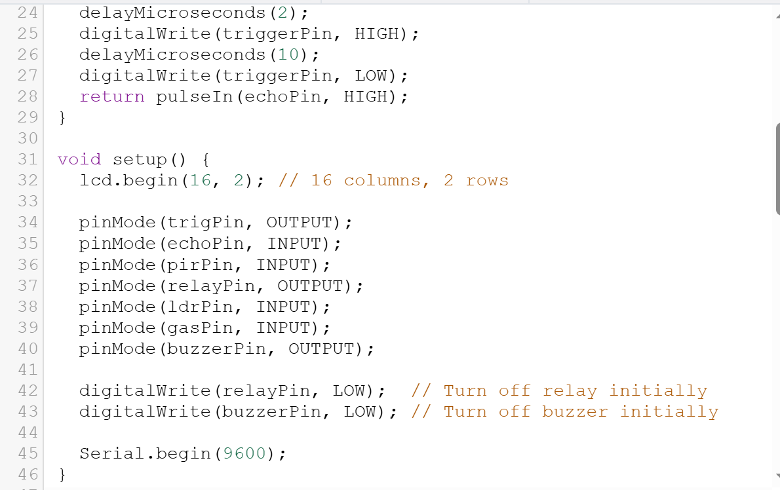
CODE

Slide 7
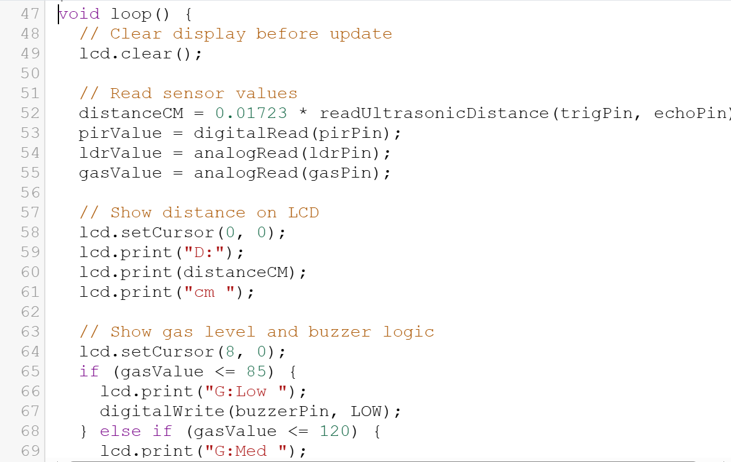
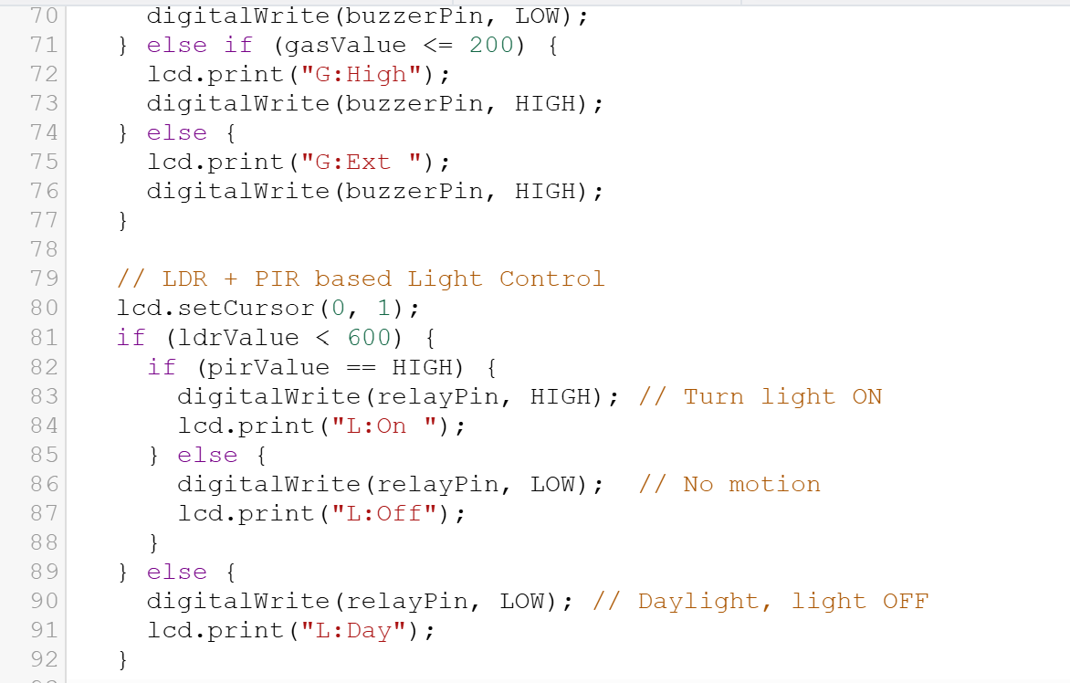
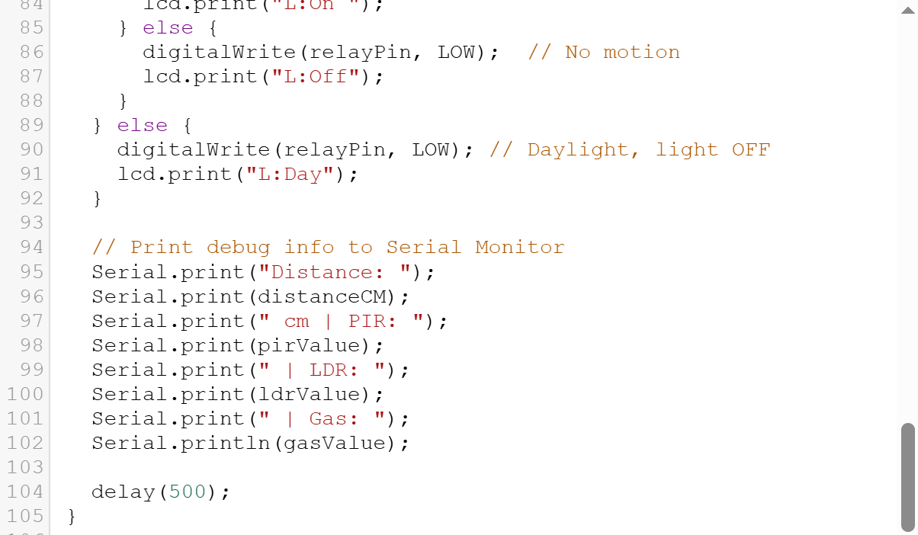

Slide 8
ARDUINO CODE OVERVIEW
LDR controls a relay to switch a bulb based on light intensity
PIR sensor detects motion and controls dc motor
GAS sensor detects LPG leakage and activates a buzzer
LCD displays sensor readings and system messages

Slide 9
LDR AND RELAY CONTROL
LDR Monitors ambient light
If light intensity <600, bulb turns OFF.
If >600, darkness bulb turns ON
LCD displays current light value and status

Slide 10
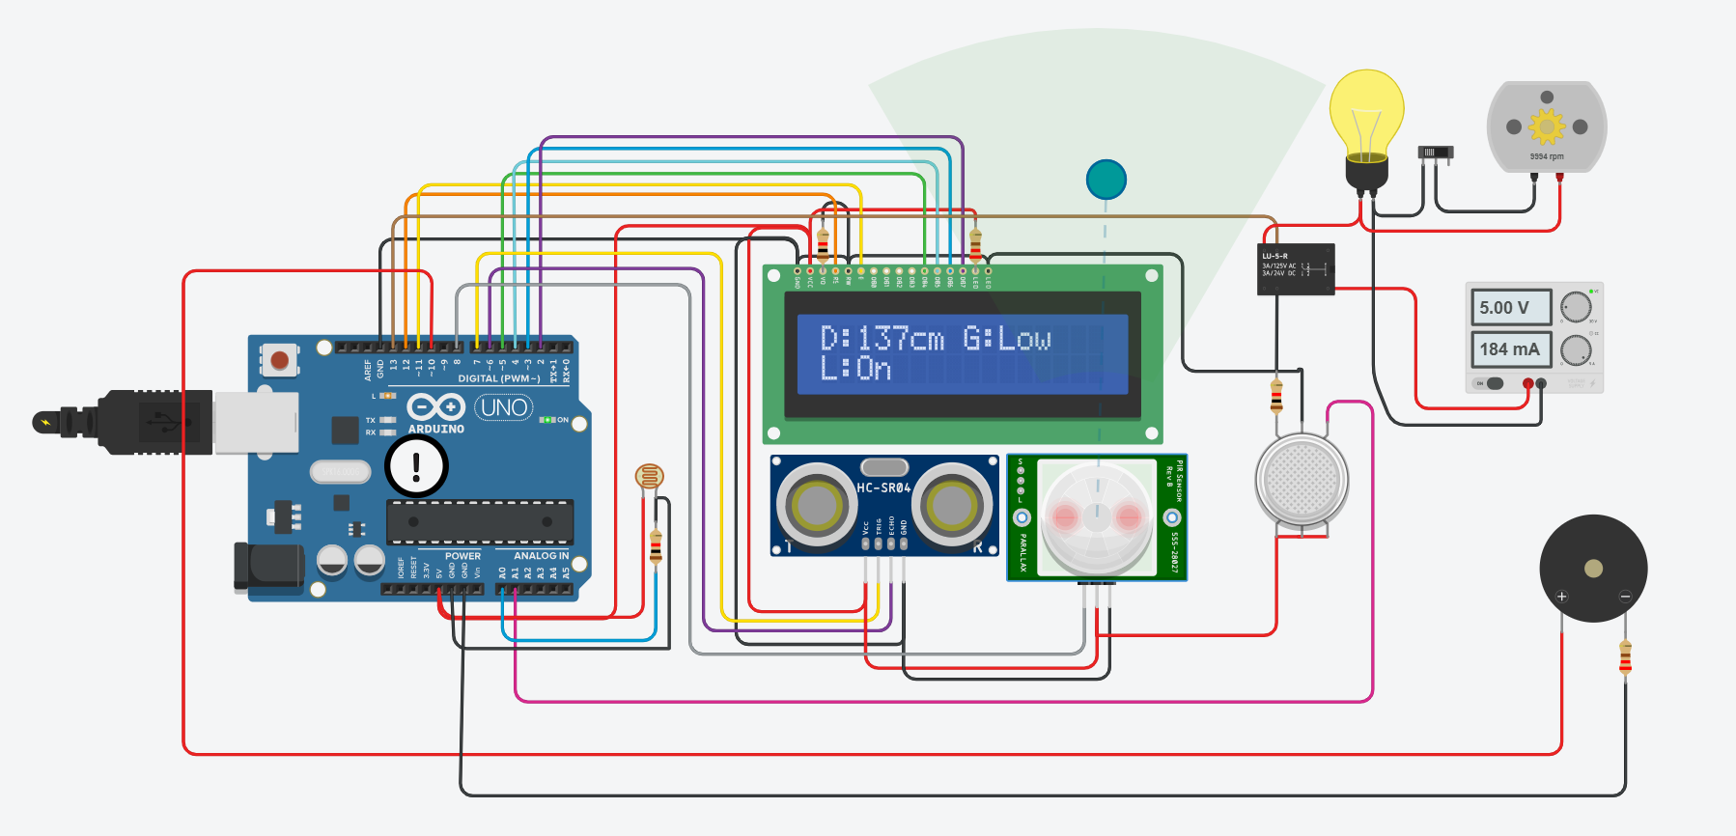
If light intensity>600, bulb turns ON

Slide 11
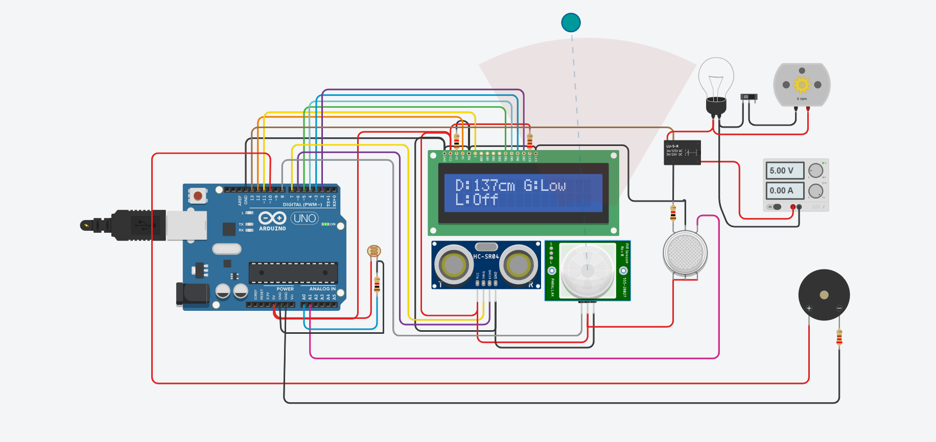
If light intensity<600, bulb turns OFF

Slide 12
PIR MOTION DETECTION
PIR sensor detects human movement
If motion detected: MOTOR ROTATES, BULB TURNS ON
If no motion detected: MOTOR STOPS, BULB TURNS OFF

Slide 13
WHEN MOTION DETECTED : MOTOR ROTATES, BULB TURNS ON

Slide 14
GAS DETECTION AND ALARM
MQ-2 gas sensor detects gas concentration.
If value <=85 LCD display LOW
If value <=120 LCD display MED
If value =200 LCD display HIGH
If value <200LCD display EXT
If value above 200 then buzzer turns ON

Slide 15
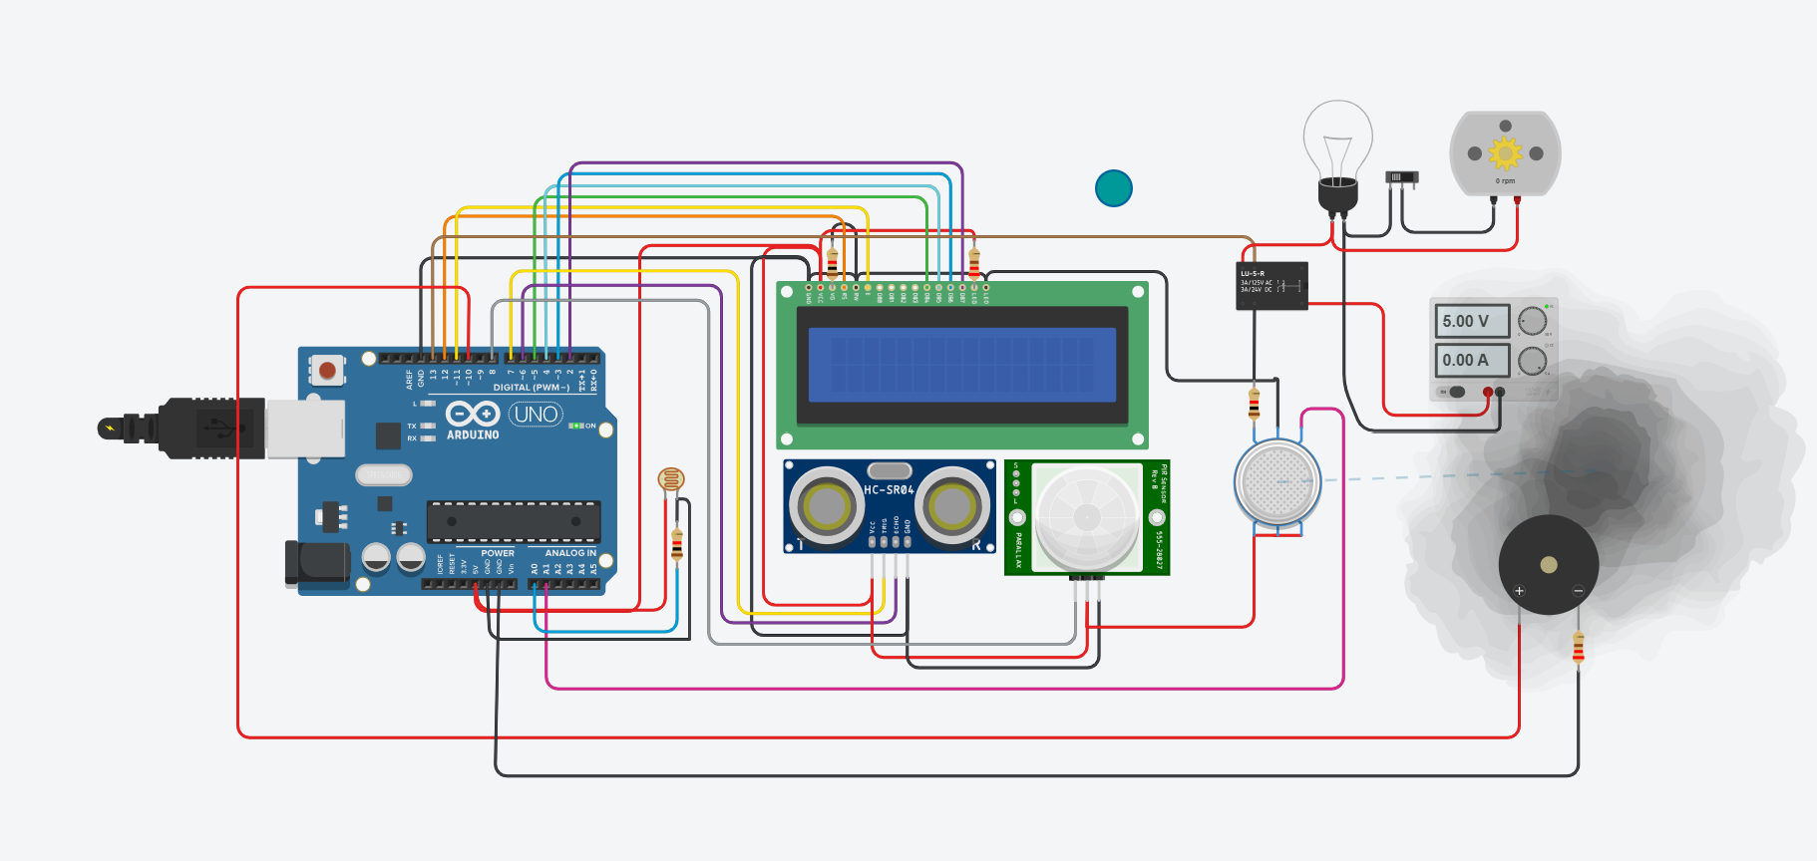
If value <=85 LCD display LOW

Slide 16
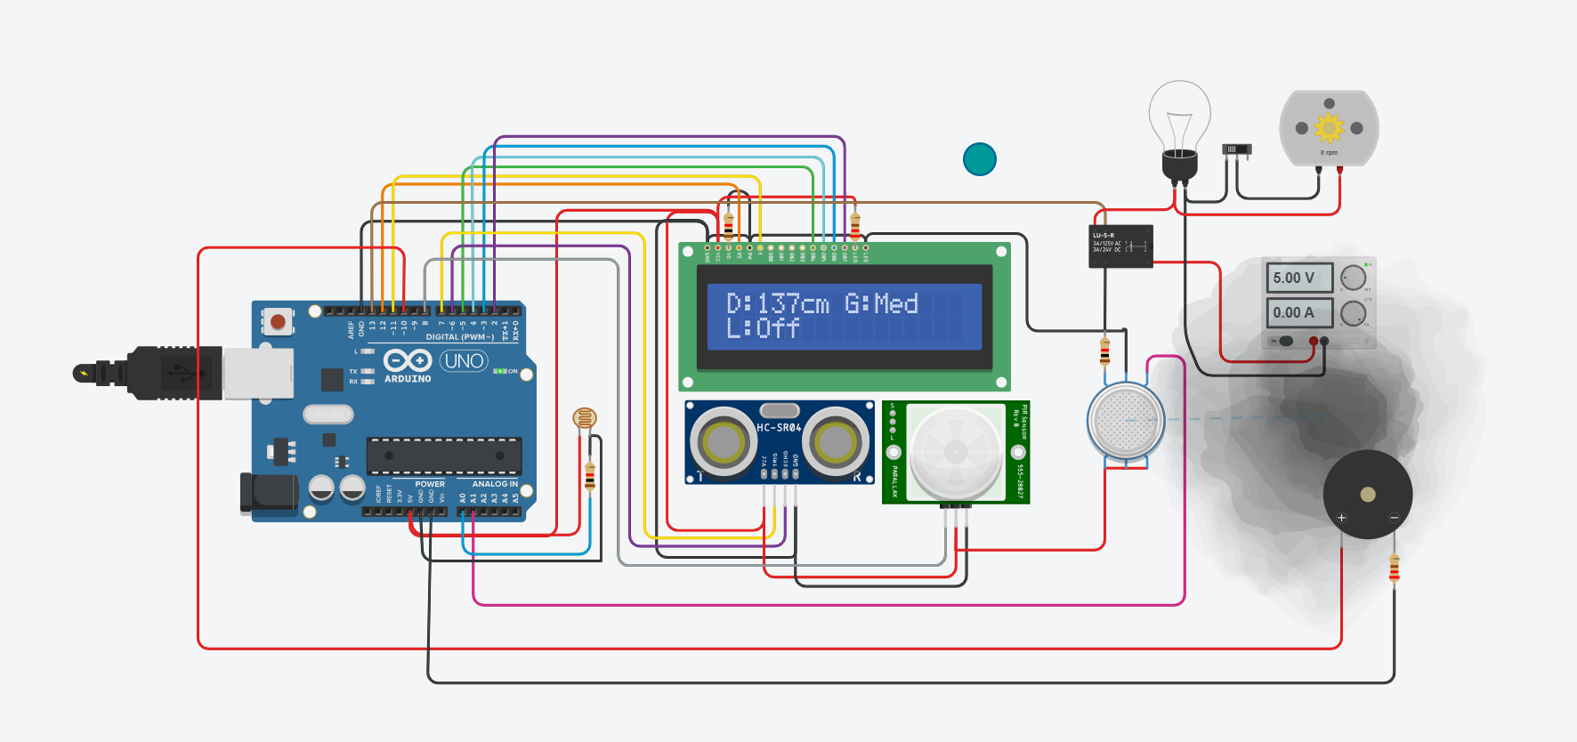
If value <=120 LCD display MED

Slide 17
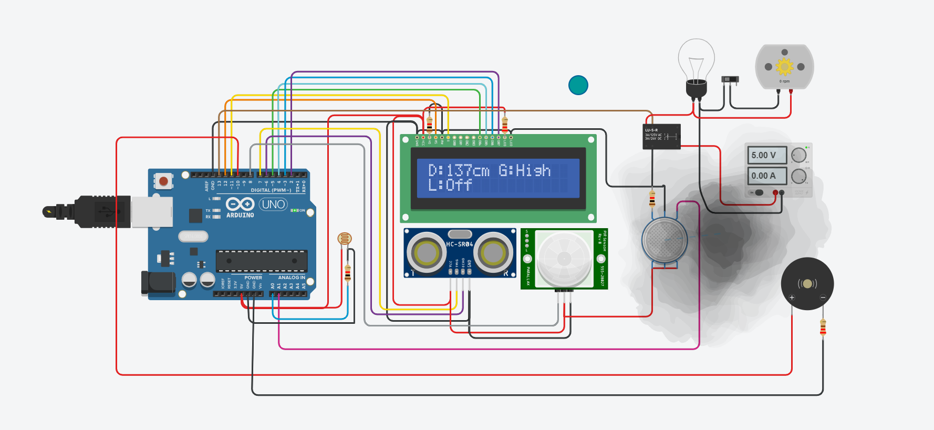
If value <=200 LCD display HIGH

Slide 18
CONCLUSION
Integrates various sensors and modules into a smart home model.
Helps automate lighting, security, gas leakage alert.
Ideal for low-cost ,Arduino-based home automation projects.

Slide 19
THANK YOU

